Slide 1

Powering Your Boat
Chapter
10

Slide 2
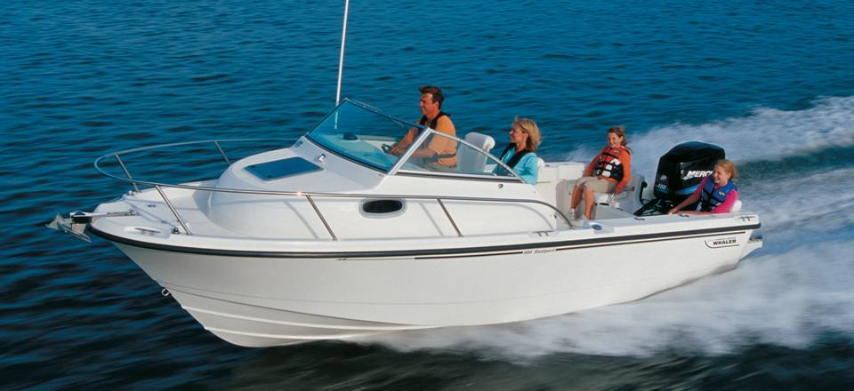
Powering Your Boat
Chapter
10

Slide 3

Lesson Objectives
Types and characteristics of marine engines
Two and four stroke engines
Operation and care
Gasoline selection
Battery maintenance

Slide 4
Lesson Objectives
Electrical system
Galvanic action
Winterizing and commissioning
Trouble shooting

Slide 5
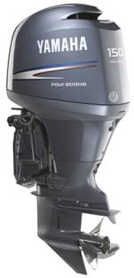
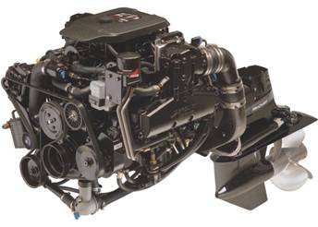
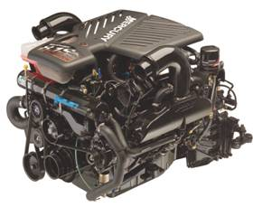
Types of Marine Engines
Installation
Inboard/outboard
(stern drive)
Outboard
Inboard

Slide 6
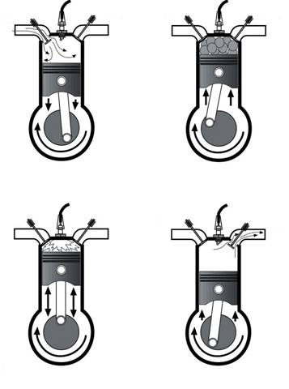
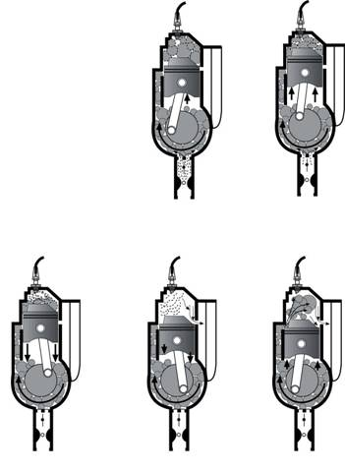
Types of Marine Engines
Operating Cycle
Intake
Exhaust
Intake
Exhaust
Intake Port
Exhaust Port
1
2
1
2
Four-Stroke
Two-Stroke
Intake
Exhaust
Intake
Exhaust
3
4
3
4
5

Slide 7
Types of Marine Engines
Types of fuel used
  Diesel
  Gasoline
Diesel Engines
  More efficient than gas engines
  Cost about the same for fuel
  Larger and heavier than gas engines
  More expensive

Slide 8
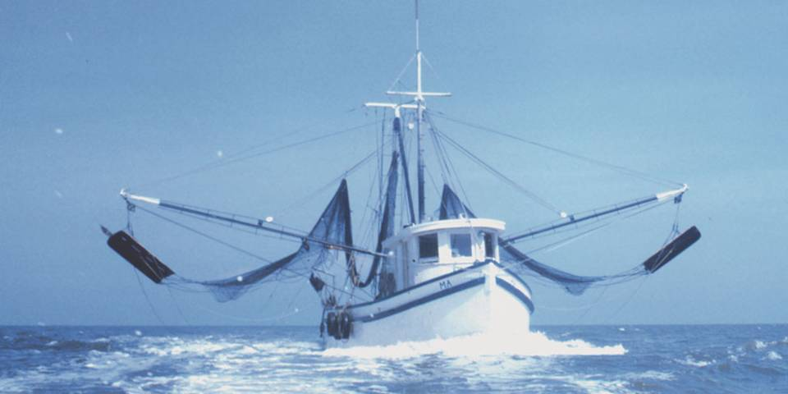
Types of Marine Engines
Risks from fuel
  Gasoline – volatile and gives off fumes
  Diesel – Higher flash point less volatile

Slide 9
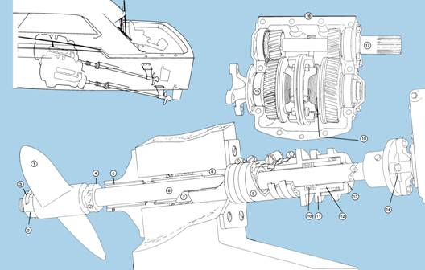
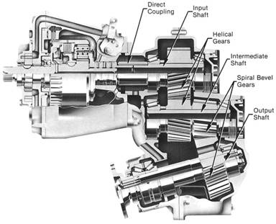
Types of Marine Engines
Inboard engines
Direct - Drive
V - Drive
Reprinted with permission from Boatowner’s Mechanical and Electrical Manual, Third Edition, by Nigel Calder

Slide 10
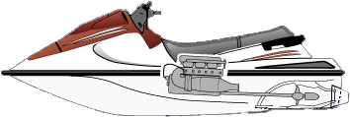
Types of Marine Engines
Jet drives
  Power from pulling water in and expelling it
  Steering requires directing water jet

Slide 11
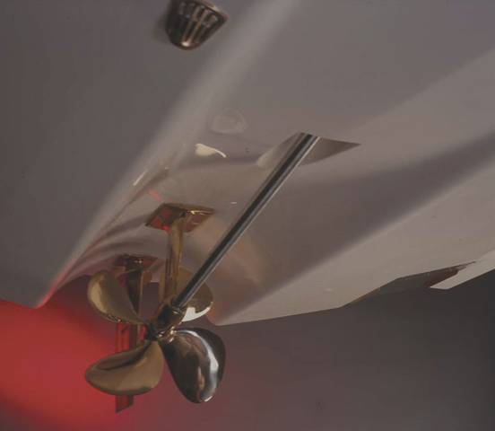
Types of Marine Engines
Tunnel drives
  Variant of a direct drive
  Efficient forward thrust
  Hull acts as protective shroud making it ideal for shallow waters

Slide 12
Types of Marine Engines
Stern drive vs. Outboard
  Outboards weight less for comparable power
  Stern drive uses 15% to 30% less fuel
  Stern drive requires more deck space
  Stern drives are more quiet
  Outboats move engine and electrical outside boat
  Most boats outlast engines so in time replacing an outboard may be easier

Slide 13
Student Activity
Name types of Marine engines
Inboard
I/O Stern
Outboard
Jet Drive
Notes:
Instructor Notes:
Ask: why each of these is an important safety consideration?

Slide 14
Induction Systems
Carburetor
  Older technology for mixing gas and air
Fuel injection
  In many cases has replaced carburetor
  Use small computer ‘black box’ for better fuel usage and operation of the engine

Slide 15
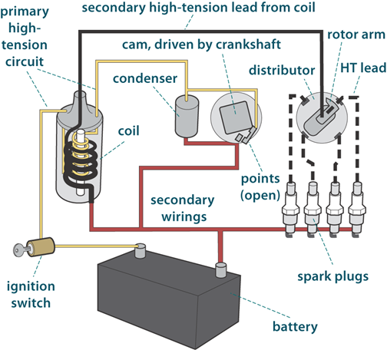
Ignition Systems
Diesel
Gasoline
  Magneto ignition
  Alternator battery
  Magneto
  Electronic

Slide 16
Cooling Systems
Air cooled system
Open (seawater) cooling system
  Fewer parts to fail
Closed (freshwater) cooling system
  Better for engine, but…
  More complicated
  Needs seawater pump and heat exchanger

Slide 17
Gasoline Considerations
Octane rating
Ethanol content?
Is engine rated to use ethanol?
Fuel tanks
  Clean and rust-free
  Free of dirt, grime, oil, etc.
  Secured firmly to boat

Slide 18
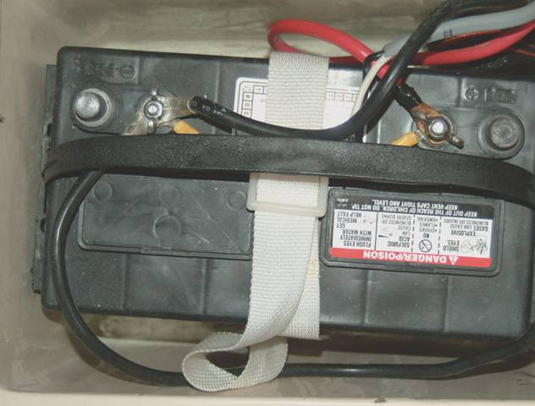
Batteries
Charged
Switch
Secure

Slide 19
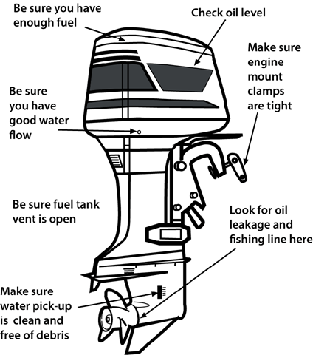
Maintenance
Lubrication
Crankcase
Bilge pumps
Belts
Ignition system
Reprinted with permission from Outboard Engines by Edwin R. Sherman

Slide 20
Winterizing Your Boat
Crankcase
Transmission
Fuel tank
Gasoline engine
Cooling systems
Lower units
Ignition system
Freshwater system
Heads and Galley

Slide 21


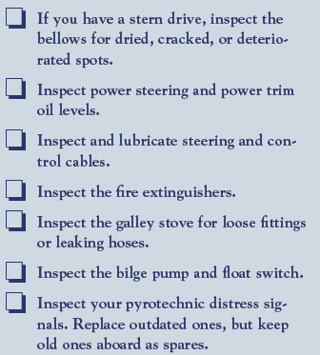
Spring Fitting Out

Slide 22
Trouble Shooting
Engine won’t turn over
Engine won’t start
Engine runs rough
Engine idles but does not develop full power

Slide 23

Thank you
Illustrations provided by McGraw Hill Education
The

